Slide 1
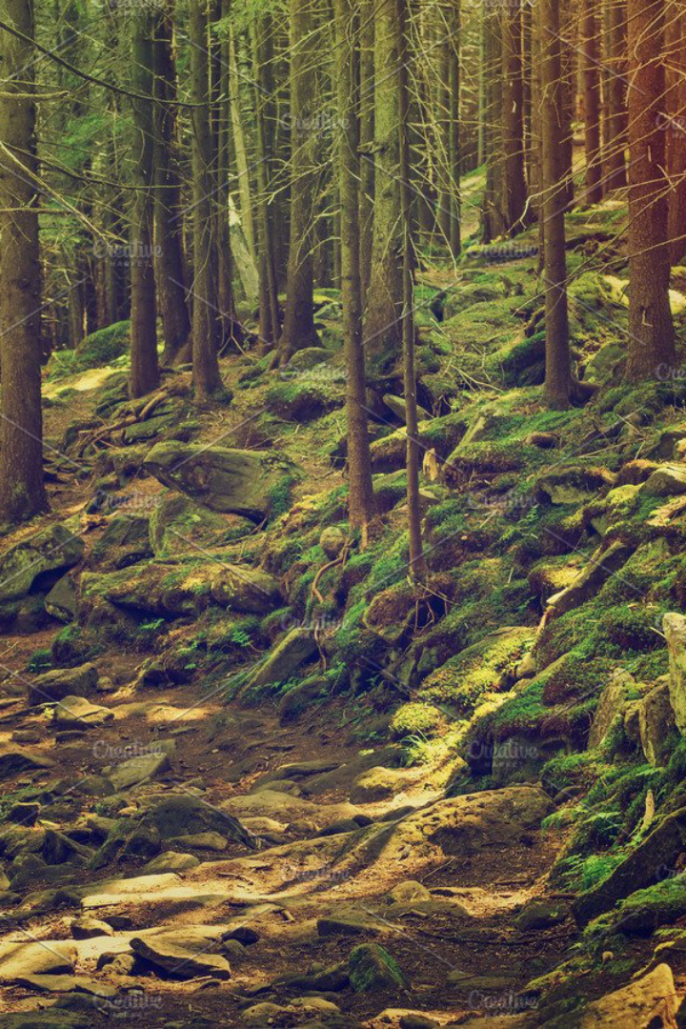
​​TEAM NAME:- HRS
Microsoft Imagine Cup 2023
DETECTING DEFORESTATION USING FOUNDATION MODEL
Microsoft Imagine Cup 2023:- GeoAI Reimagined: Transformative and Diverse Earth Science Applications Using Foundation Models
MEMBERS :-
Harsh Kumar

Slide 2
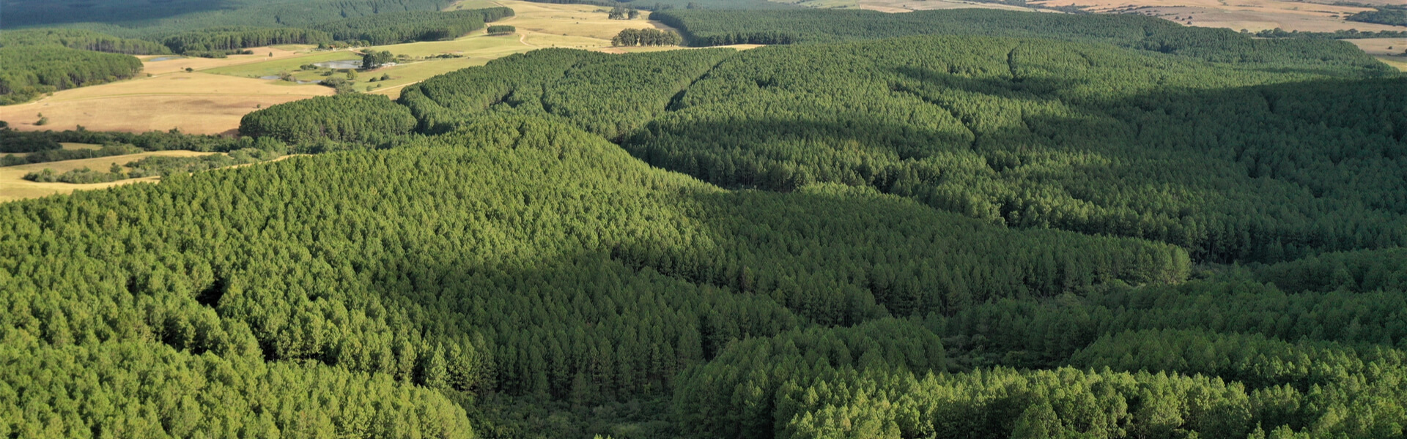
INTRODUCTION
OUR CHALLENGE
In our project, "Detecting Deforestation using Fine-tuned Crop Detection Models," we're addressing a pressing issue: deforestation. This destructive practice, fueled by activities like logging and expanding agriculture, wreaks havoc on our environment. It leads to biodiversity loss, worsens climate change, disrupts water systems, and damages ecosystems.
WHAT WE PLAN TO DO?
Our plan is and more sustainable future. simple yet impactful. We're using a specialized foundation model called Prithvi-100m-multi-temporal-crop-classification to spot deforestation patterns early. This technology helps us take prompt action, promote conservation, and minimize environmental harm, all in the pursuit of a greener

Slide 3

OBJECTIVES
1
OBJECTIVE 1
2
OBJECTIIVE 2
3
OBJECTIVE 3
4
OBJECTIVE 4
Develop AI models that require minimal labeled data and are generalizable across various applications, as well as spatial and temporal domains.
To use existing specialized models for geospatial (earth-related) tasks and adjusting them to work better for specific purposes using data from satellites and other remote sensing sources.
Detecting changes in a
given area based on
related events
Quantify deforestation in respective region.

Slide 4
APPROACHES
1
Pixel-Wise Change Detection.
This method involves comparing individual pixel values between two images to identify changes based on a specific criterion, such as a change in pixel intensity.
Specifically, performing "Intensity-Based Pixel-Wise Change Detection" because we are comparing pixel intensities and detecting changes based on a specific intensity value.
Tile-Based Intensity-Based Change Detection
2
For each tile, it calculates the absolute difference between the corresponding regions in the two images (tile1 and tile2).
Then, it creates a mask (intensity_1_mask) to identify pixels with intensity 1 in tile1.
Finally, it applies a threshold to detect changes from intensity 1 in the difference map, resulting in a tile-level change map .
This method is suitable for detecting changes in intensity value 1 in a large raster image efficiently by processing the image in manageable tiles.
3
TEMPORAL ANALYSIS APPROACH:-
•Temporal analysis is the study of data or events over time to discern patterns and trends, aiding in understanding how things change and evolve.

Slide 5
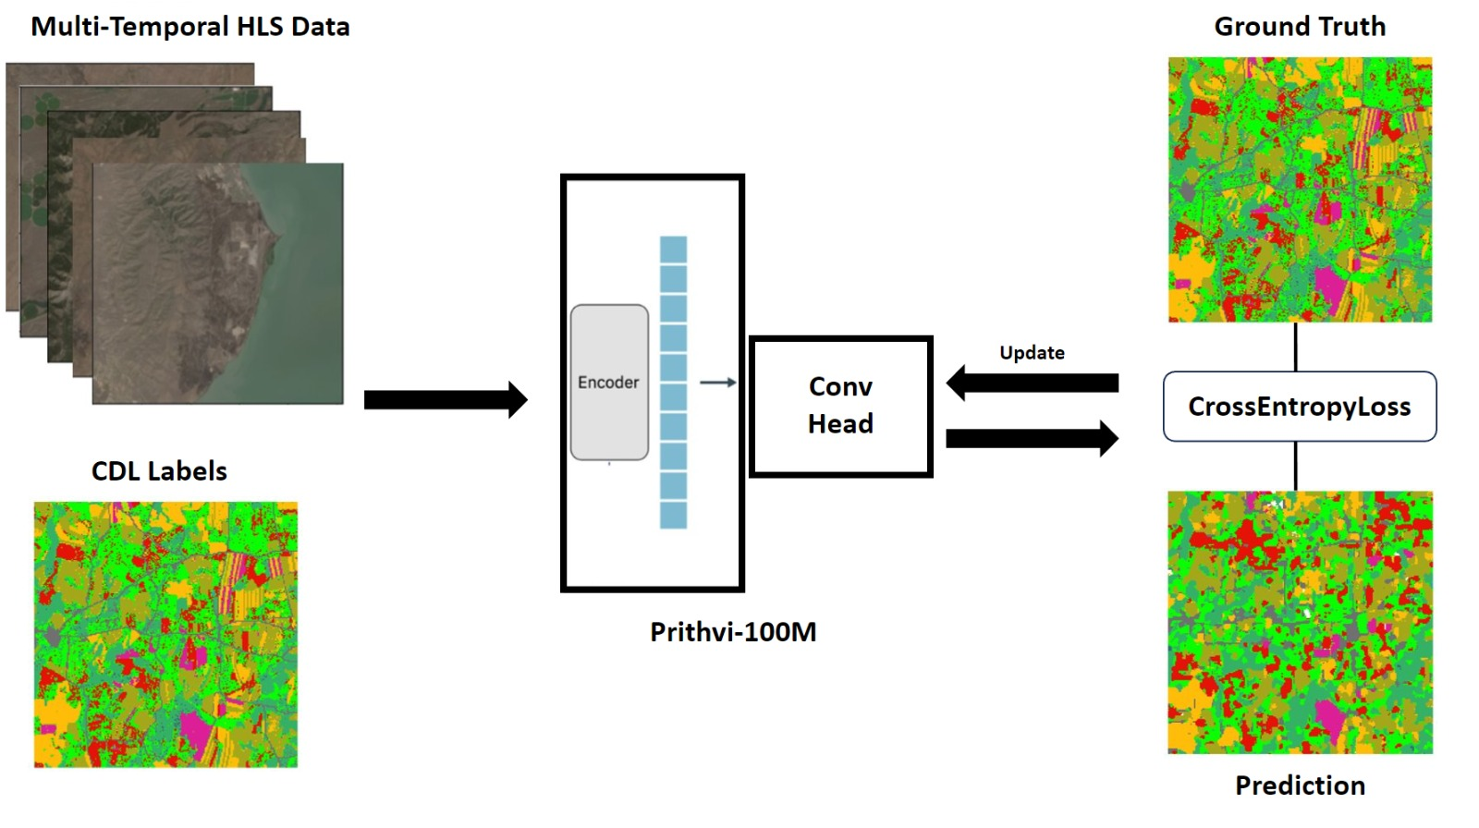
PRITHVII 100M
PRITHVI-100M- MULTI-TEMPORAL-CROP-CLASSIFICATION.
The pretrained Prithvi-100m parameter model is finetuned to classify crop and other land cover types based off HLS data and CDL labels from the multi-temporal-crop-classification dataset.
This dataset includes input chips of 224x224x18, where 224 is the height and width and 18 is combined with 6 bands of 3 time-steps. The bands are:
Blue
Green
Red
Narrow NIR
SWIR 1
SWIR 2

Slide 6

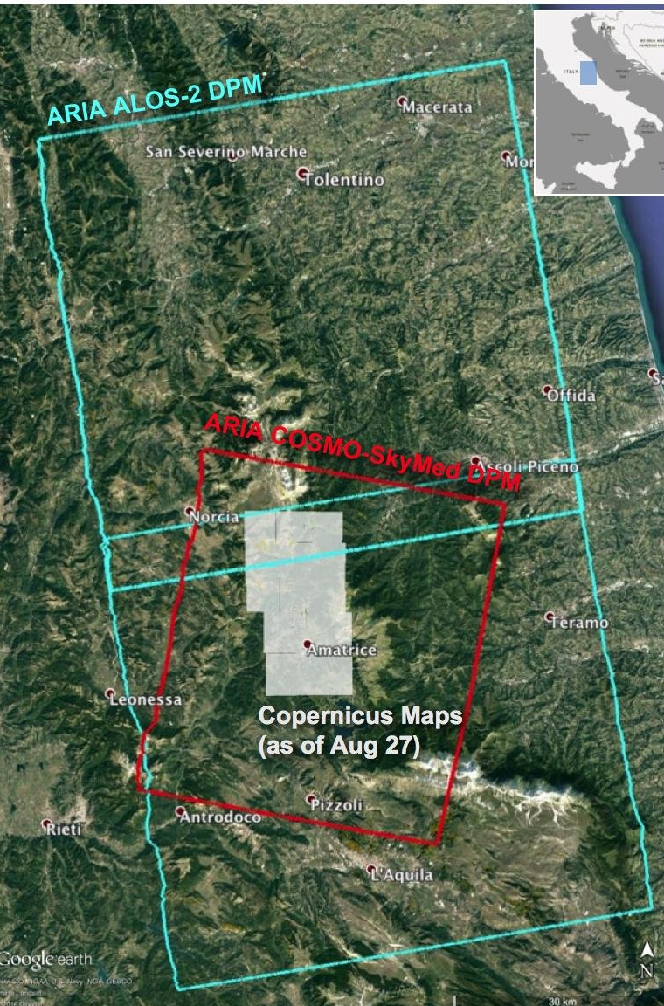
Challenges and Considerations in Implementing AI for Deforestation Detection
1
DATA AVAILABILITY
2
COMPUTATIONAL POWER
Unavailability of proper data from government sites, local data repositories, etc
PRITHVII 100M is based on transformer encoding decoding which is trained on huge amount of data . Therefore requires high computational power.
3
INPUT DATA FORMAT
Model requires the data to be in geo tiff format with multi spectral bands . The regular PNG, JPEG formats wont be compatible for the project .

Slide 7
IMPACT/ USE CASE
Timely Detection of Deforestation:
Environmental Impact: GeoAI allows for the real-time or near-real-time detection of deforestation activities. This timely detection can enable rapid response efforts to mitigate further damage to ecosystems, biodiversity, and carbon sequestration.
Improved Conservation Efforts:
Environmental Impact: The accurate monitoring of deforestation helps conservationists and environmental agencies target their efforts more effectively. It enables the identification of critical areas for protection and the implementation of conservation strategies.
Biodiversity Protection:
Environmental Impact: Monitoring deforestation allows for the protection of critical habitats and ecosystems, helping to safeguard biodiversity and the species that depend on these areas.
Resource Management:
Socioeconomic Impact: GeoAI aids in sustainable resource management. It helps communities and governments make informed decisions about land use, logging, and agriculture, balancing economic development with environmental conservation.
Policy and Enforcement:
Socioeconomic Impact: The project's data and insights can inform policy decisions related to land use and deforestation regulation. Enhanced monitoring can also support law enforcement efforts against illegal logging and land clearing.

Slide 8
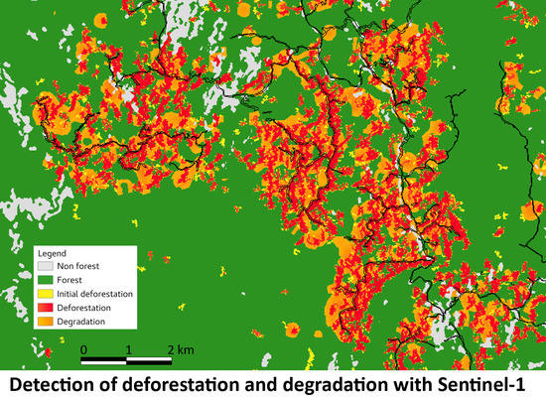
Conclusion and Future Implications
Conclusion: The deforestation monitoring project using GeoAI has made significant strides in combatting deforestation, benefitting both the environment and society. Timely detection, advanced algorithms, and data-driven policy changes have played a pivotal role
Future Directions: To build on this success, the project should explore higher spatial resolutions, multi-sensor data integration, improved machine learning, global collaboration, community involvement, open data access, real-time monitoring, and policy advocacy. These efforts will enhance the project's impact and contribute to forest conservation and sustainable land use.

Slide 9
CITATIONS
https://data.ornldaac.earthdata.nasa.gov/protected/cms/CMS_Pantropical_Forest_Biomass/data/AGLB_Deforested_Tropical_Asia_2000.tif- downloading the deforestation dataset for implementation.
https://search.earthdata.nasa.gov/search/granules?p=C2389022166-ORNL_CLOUD&pg[0][v]=f&pg[0][gsk]=-start_date&tl=1696667867.891!3!!&fs10=deforestation&fsm0=habitat%20conversion/fragmentation&fst0=human%20dimensions- downloading the deforestation dataset
https://www.earthdata.nasa.gov/news/impact-ibm-hls-foundation-model- To know more about foundation model

